Slide 1
Cartoon #1 in the Market Systems Learning Series
Market Systems Resilience
An Introduction

Slide 2
This document was made possible through the support provided by Feed the Future through the U.S. Agency for International Development, under the terms of the Feed the Future Market Systems and Partnerships Contract No. 7200AA20C00054, managed by DAI. It was prepared by the Vikāra Institute. The opinions expressed herein are those of the author(s) and do not necessarily reflect the views of USAID or the U.S. Government. MSP is advancing learning and good practice in market systems development and private sector engagement within USAID, USAID partners, and market actors. For more information, visit www.agrilinks.org/msp.
ACKNOWLEDGEMENTS
This cartoon is part of a cartoon learning series developed by the Vikāra Institute.
The series developed for USAID can be found at www.marketlinks.org/resources/cartoon-learning-series and www.marketlinks.org/resources/market-systems-resilience-learning-resources-series.
The entire cartoon learning series can be found at www.VikaraInstitute.org/cartoons.
Additional MSR resources and learning tools, can be found at:
www.marketlinks.org/resources/market-systems-resilience-learning-resources-series.
HOW TO USE
The cartoon learning series can be used in individual or group settings as a learning and training tool for market development practitioners and donors. The cartoons can be given to new team members to review or be used to stimulate group discussion in training settings.

Slide 3
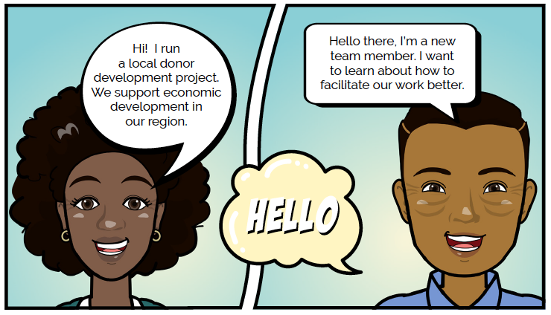

Slide 4
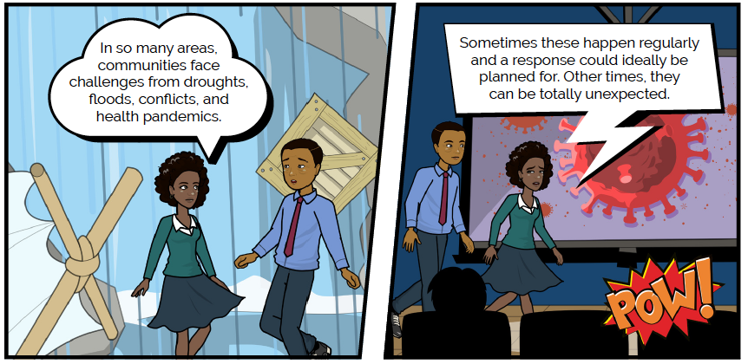

Slide 5
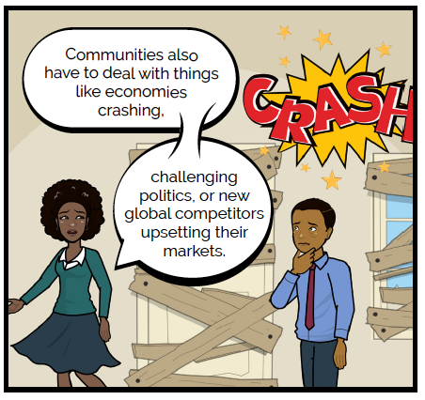

Slide 6
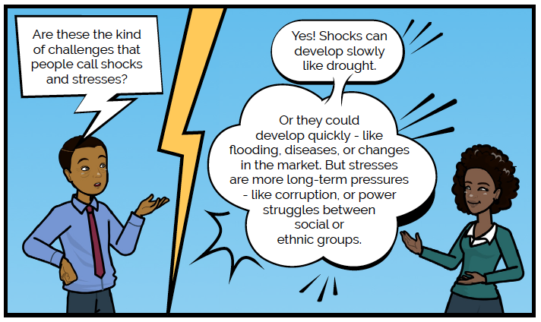

Slide 7
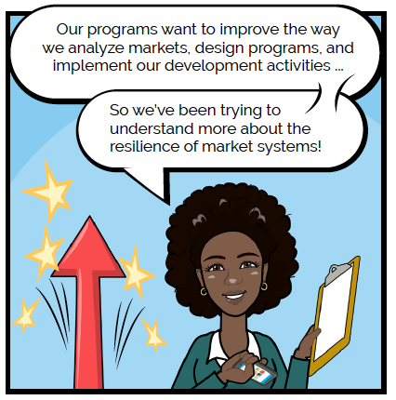

Slide 8
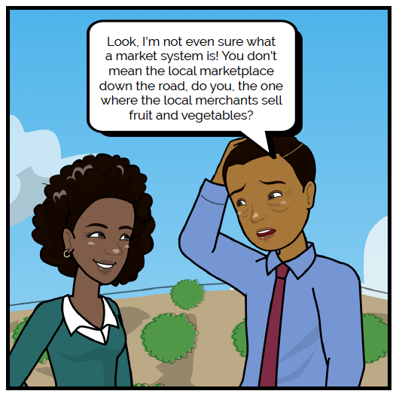

Slide 9
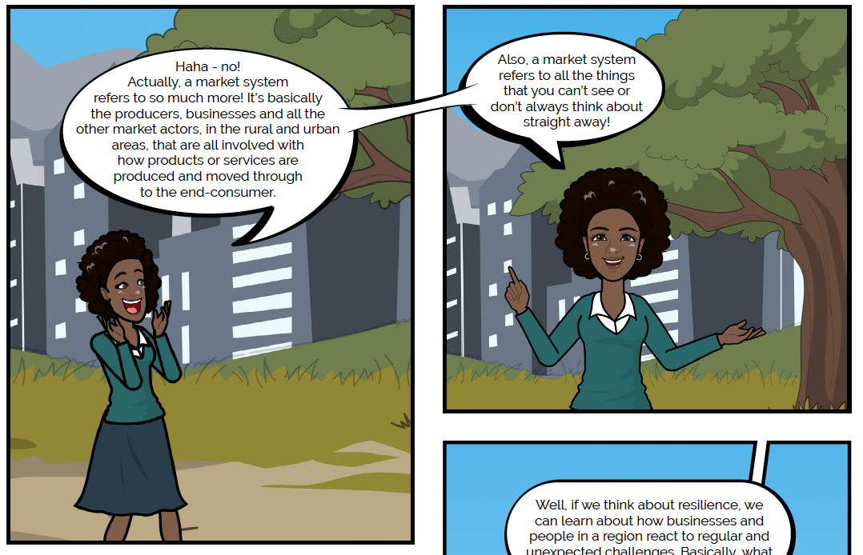

Slide 11
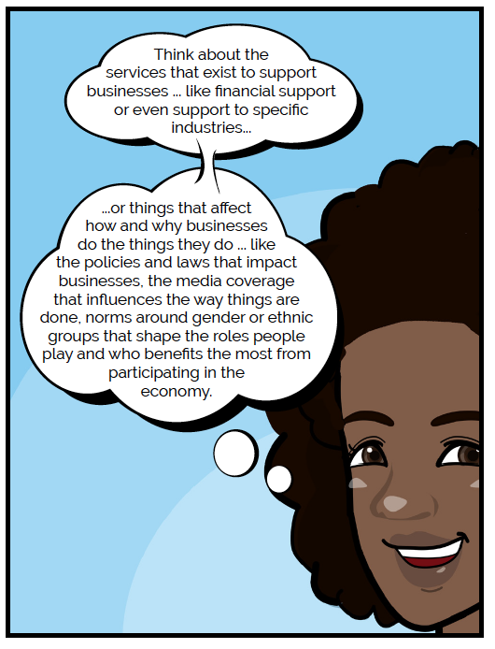

Slide 14
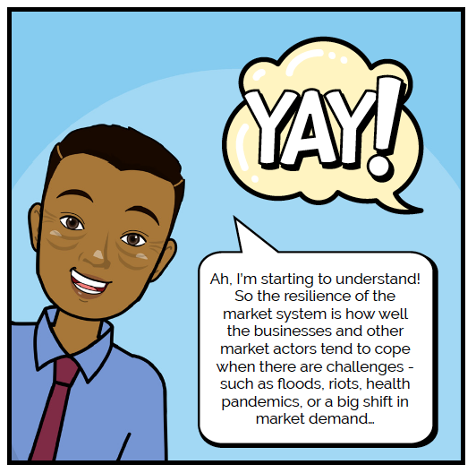

Slide 15
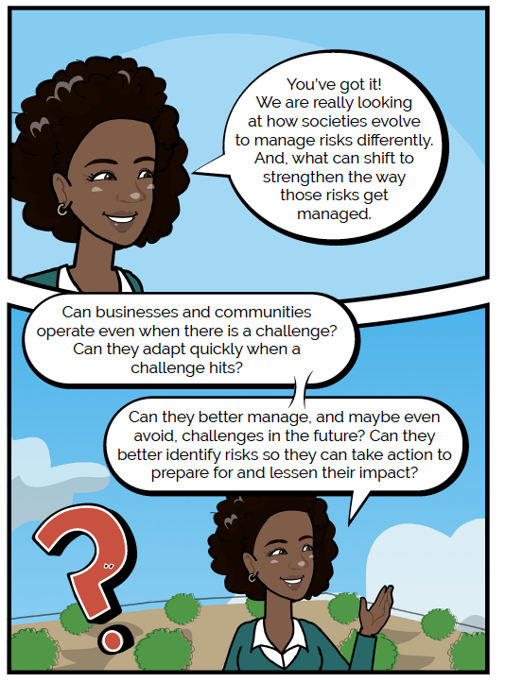

Slide 16
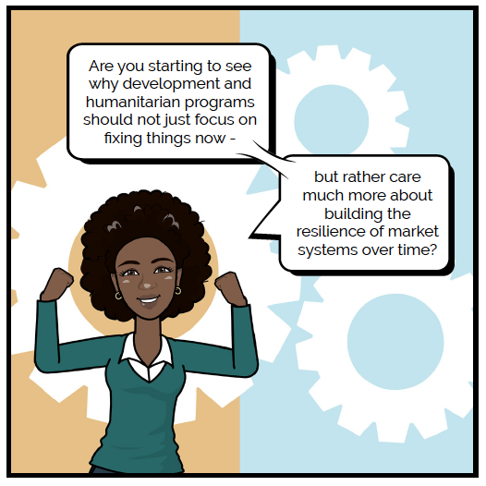

Slide 17
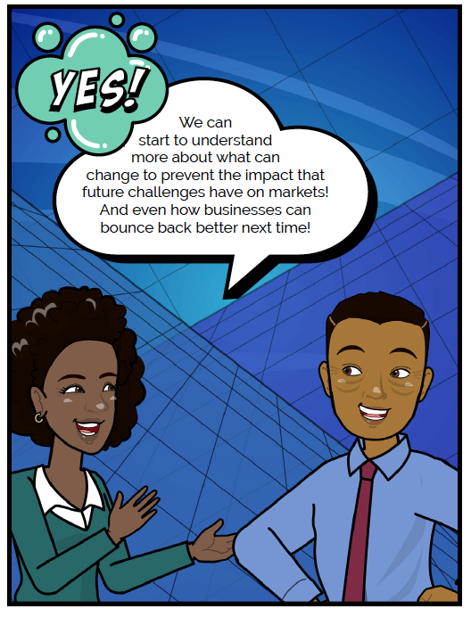

Slide 18
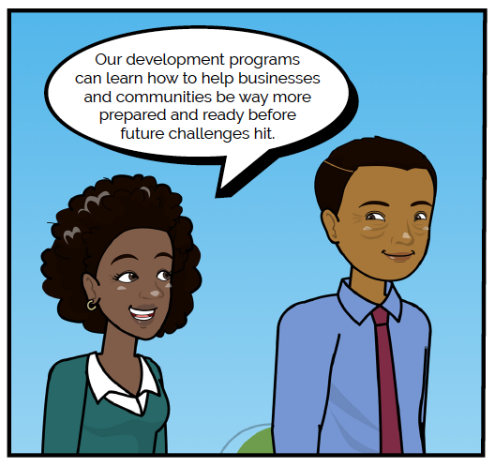

Slide 19
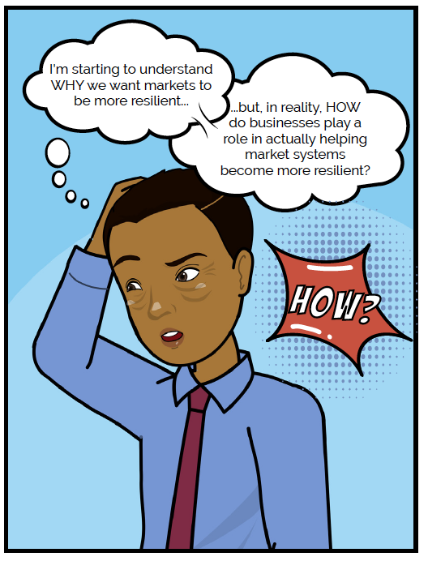

Slide 20
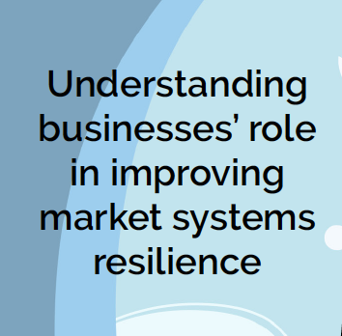

Slide 21
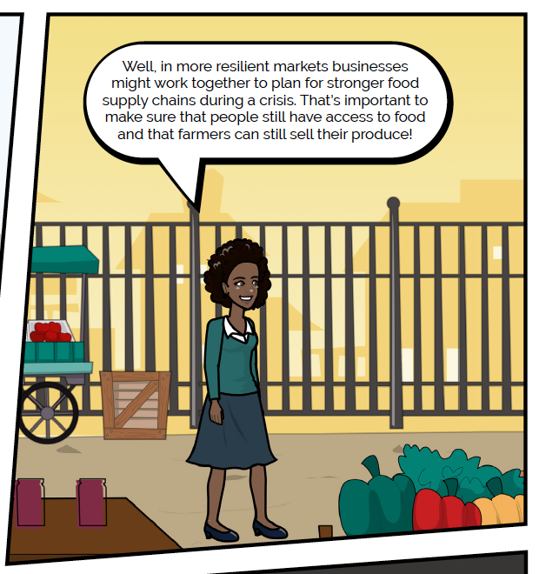

Slide 22
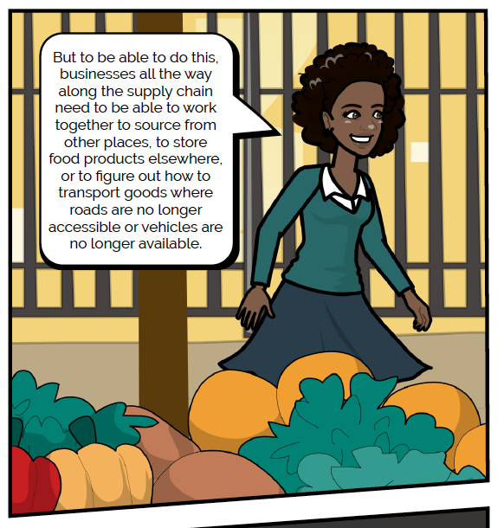

Slide 23
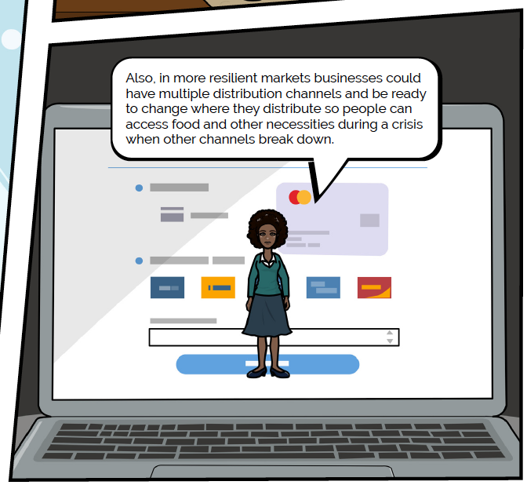

Slide 24
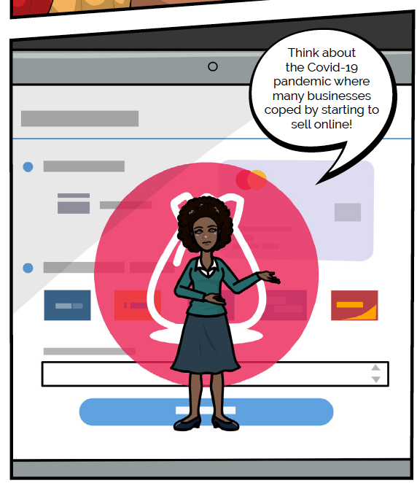

Slide 25
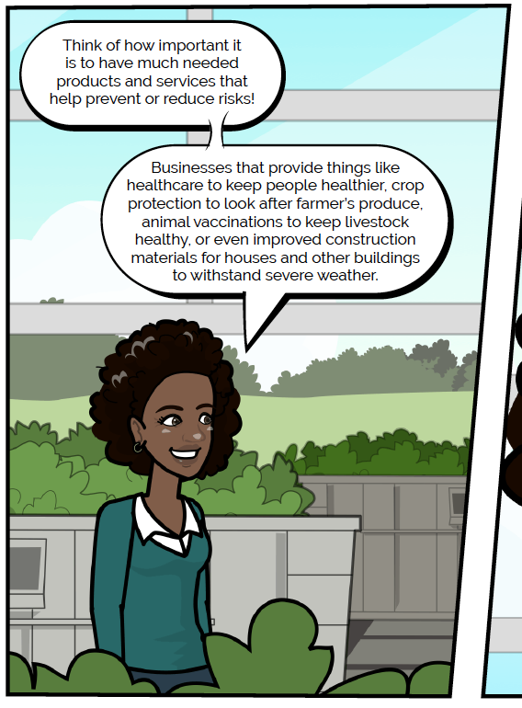

Slide 26
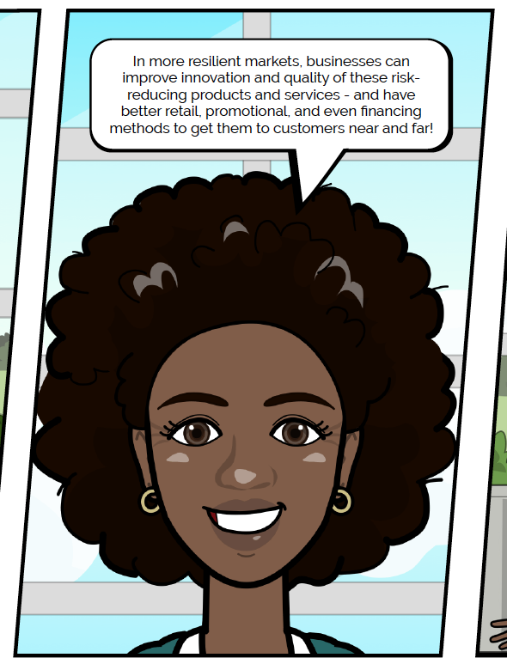

Slide 27
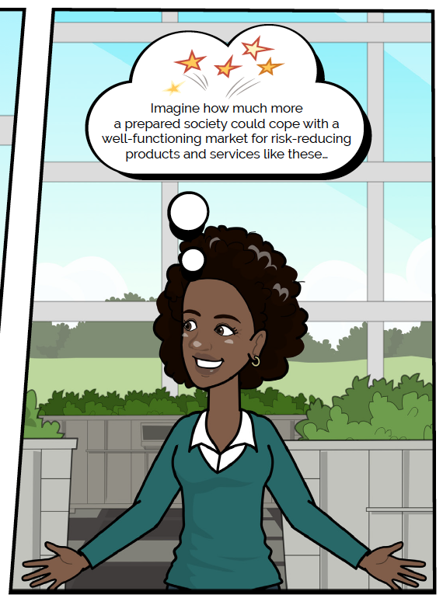

Slide 28
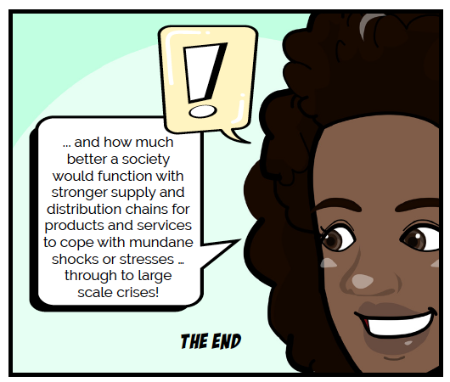

Slide 29
OTHER CARTOONS IN THE SERIES:
This cartoon forms part of a larger cartoon learning series. Next, read the second cartoon in this learning series on “Analyzing Market System Resiliency” for guidance on the domains that programs can use to analyze market resilience patterns.

